Slide 1

Characteristics of Technical Reports
Technical Communication for Engineers
Notes:
Technical reports include various types of "technical" information. For example, if you need to report why a design or piece of equipment failed, you'd write a forensic report. Or, you might have to write about a design you created. Then, you'd produce a design report. Technical reports present facts and conclusions about your designs and other projects. Typically, a technical report includes research about technical concepts as well as graphical depictions of designs and data. A technical report also follows a strict organization. This way, when other engineers read what you write, they can quickly locate the information that interests them the most.

Slide 2

Purpose
Primary Purposes:
Inform
Persuade
Recommend
Analyze
Technical Communication for Engineers

Slide 3

Multiple Audiences
High-Tech
Managerial
Low-Tech
What do they know?
What do they need to know?
Will they skim the document or read from beginning to end?
What do you want them to do with the information?
Technical Communication for Engineers
Notes:
As an engineer in the field, the most likely audience for the technical reports you produce is other engineers with a background similar to yours. This audience is more likely to understand the terminology you use. However, you should always evaluate who your readers will be before assuming they will understand your jargon. You shouldn't always assume that your audience has a strong engineering background or is familiar with the engineering terminology you use.

Slide 4

Genres for Formal Reports
Uses the ABC approach
Usually covers more complicated projects
Are typically multiple pages
Contains special elements (table of contents, appendix, etc.)
May have a more diverse set of readers (a status report may go to one audience type; a proposal to several audience types)
Types of Formal Reports
Research or design reports
Journal publications
Proposals
Remember: Genre consists of both format and function.
Technical Communication for Engineers
Notes:
Discuss the difference between letters and memos (the letter format is used when an informal report is written for audiences outside your company; the memo format is used when an informal report is written for audiences inside your company. Proposals can be either formal or informal reports depending on whether they are solicited or unsolicited, internal or external

Slide 5
Genres for Informal Reports
Use the ABC format design
Can be formatted as a business letter or memo (review business correspondence slides in Canvas)
Types of Informal Reports
Progress/status reports
Safety reports
Site visit reports
Proposals
(proposals can be both formal and informal)
Remember: Consult the style manual of your company or discipline for format guidelines.
Technical Communication for Engineers
Notes:
Reports can either be informal or formal. The primary differences between formal and informal reports are complexity of subject matter and length. Discuss the difference between letters and memos (the letter format is used when an informal report is written for audiences outside your company; the memo format is used when an informal report is written for audiences inside your company. Proposals can be either formal or informal reports depending on whether they are solicited or unsolicited, internal or external

Slide 6
Basic Format Guidelines
Single-spaced, left justify content, 1” margins
Formal reports are usually spiral bound (adjust left margin to 1.25” if binding)
Times New Roman (12 pt. font)
Use headings to organize content
One blank line between paragraphs
No paragraph indentation
Technical Communication for Engineers

Slide 7
Basic Format Guidelines, cont.
Contain page numbers (check style guides to identify location of page number on page)
Printed on one side of the paper
Written in active voice (unless genre dictates otherwise: lab report)
Can be written in first, second, or third person
Technical Communication for Engineers

Slide 8
Unique Features of
Technical Reports
Headings
Lists
Technical definitions and descriptions
Graphs, charts, illustrations, pictures, tables, figures, and equations
Tables of content, appendices, title pages (formal reports)
Technical Communication for Engineers

Slide 9
Headings
Headings identify key topics in a report and should:
help organize information and act as signposts for readers
identify the main topics of your report (will be skimmed by readers)
be descriptive and parallel in construction
match the table of contents (if there is one)
be organized by level (1st, 2nd, 3rd, 4th)
be set off with white space
be consistent in capitalization of words
Technical Communication for Engineers

Slide 10
Headings: When to Capitalize
General Rules:
Capitalize the first letter of principal words and proper nouns
Don’t capitalize articles (a, an, the), coordinating conjunctions (FANBOYS), and prepositions
Technical Communication for Engineers
Notes:
Two common methods to capitalizing titles: Sentence case and title case. Style guides differ in which to use, so make sure to consult the style guide of your discipline or company. It’s the little words that tend to cause the most disagreement. This slide shows the capitalization guidelines for our class.

Slide 11
1st Level Headings
Times New Roman
either 14 point (first letter of major words capitalized) OR
all upper case, 12 point
Center and bold
One blank line below
Begins on a new page (hence, no need for one blank line above)
For shorter documents, use a centered title as the 1st level heading and then start with a second-level heading where appropriate in the body of the document
Technical Communication for Engineers

Slide 12
1st Level Headings
FIRST-LEVEL HEADING
This is an example of a first-level heading in all capital letters, 12 point font size. Center and bold. Separate the heading from the written material by placing 1 blank line after the heading.
First-Level Heading
This is an example of a first-level heading with the first letter of principal words capitalized and 14 point font size. Center and bold. Separate the heading from the written material by placing 1 blank line after the heading.
Technical Communication for Engineers

Slide 13
2nd Level Headings
Comes after a 1st level heading
Times New Roman, 12 point
Left align and bold
One blank line before and after the heading
Capitalize the first letter of principal words
Begins on the same page
Second-Level Heading
Place second-level headings flush with the left margin with at least one line space above and below, separating them from text. Capitalize only the first letter of each main word.
Technical Communication for Engineers

Slide 14
3rd Level Headings
(Paragraph Headings)
Begin on same line as first sentence of paragraph
Times New Roman; 12 point font
Bold
Capitalize the first letter of the first word only (and proper nouns)
End with a period
Third-level headings. Place third-level headings on the same line as the text they precede. Capitalize the first letter of the first word, bold the heading, and end the heading with a period.
Technical Communication for Engineers

Slide 15
4th Level Headings
(Paragraph Headings)
Same format as 3rd level headings but italicized.
Fourth-level headings. Place fourth-level headings on the same line as the text they precede. Capitalize the first letter of the first word, bold and italicize the heading, and end the heading with a period.
Technical Communication for Engineers

Slide 16
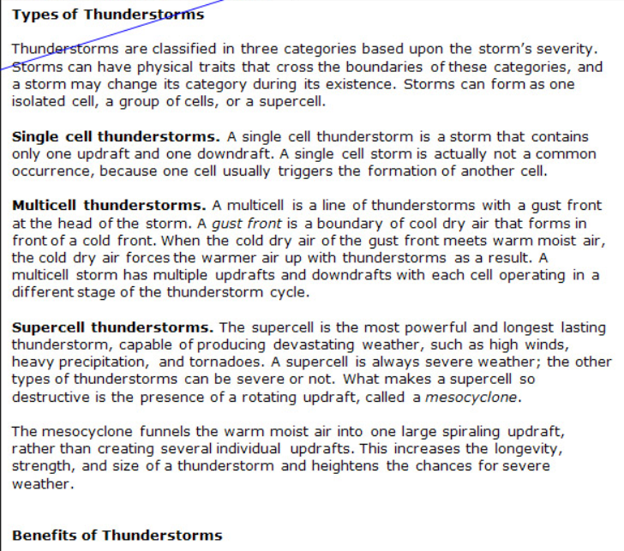
No Orphan Headings
This is an example of an orphan/widowed heading.
Technical Communication for Engineers

Slide 17
No Stacked Headings
FIRST-LEVEL HEADING
Second-Level Heading
All headings must be followed with content; otherwise, a stacked heading will occur.
Stacked headings
Technical Communication for Engineers
Notes:
A stacked heading is one heading followed by another with no content in between.

Slide 18
No Skipped Headings
FIRST-LEVEL HEADING
Third-level heading. Headings must follow hierarchy. You can’t have a third-level heading without it being part of the 2nd level structure.
NOTE: There are no required amount and/or level of headings in a report, but reports should be organized with first-level headings at a minimum.
Skipped second-level heading
Technical Communication for Engineers
Notes:
In order to have a second-level heading, you need to have a first-level heading before it. In order to have a 3rd heading, you need to have a 2nd level before it. You can’t skip levels. You can, however, have multiple 2nd and 3rd level headings all within a 1st level section.

Slide 19
Headings Should be Parallel
Conventional Headings
Introduction
Materials and Methods
Results
Discussion
Literature Cited
Informative Headings
Choose a Desired College
Complete Admissions Paperwork
Obtaining Letters of Recommendation
Apply for Financial Aid
Not parallel with the rest
Technical Communication for Engineers
Notes:
Conventional headings highlight the content in a particular section and are used for sections commonly found in reports (introduction, conclusion, discussion) and are generally read by all audiences. . Informative (or talking) headings are more informative. They help readers navigate the text by guiding them to key parts of a document and enable the reader to decide if this is a section that pertains specifically to him or her. One way to create an informative heading is to use a subject, a verb, and an object OR use an informative phrase. NOTE: informative headings are not structured as sentences.

Slide 20
Headings Can Use Numbering Systems
Traditional Outline System
TITLE
FIRST-LEVEL HEADING
A. Second-Level Heading
1. Third-level heading
2. Third-level heading
B. Second-Level Heading
II. FIRST-LEVEL HEADING
A. Second-Level Heading
1. Third-level heading
2. Third-level heading
Technical Communication for Engineers

Slide 21
Headings Can Use Numbering Systems
Century-Decade-Unit System (often called the Navy System)
TITLE
100 FIRST-LEVEL HEADING
110 Second-Level Heading
111 Third-level heading
112 Third-level heading
120 Second-Level Heading
200 FIRST-LEVEL HEADING
210 Second-Level Heading
211 Third-level heading
212 Third-level heading
220 Second-Level Heading
Technical Communication for Engineers

Slide 22
Headings Can Use Numbering Systems
Multiple Decimal System
TITLE
1 FIRST-LEVEL HEADING
1.1 Second-Level Heading
1.1.1 Third-level heading
1.1.2 Third-level heading
1.2 Second-Level Heading
2 FIRST-LEVEL HEADING
2.1 Second-Level Heading
2.1.1 Third-level heading
2.1.2 Third-level heading
2.2 Second-Level Heading
Technical Communication for Engineers

Slide 23
Which Heading System Should You Use?
Follow the style of your company, professor, journal, or client (federal government agencies typically use numbered heading systems).
Numbered headings are standard for some reports: specifications, procedures, operating manuals.
Technical Communication for Engineers
Notes:
Numbered heading systems can cause problems. If you want to add or remove a section, you have to renumber at least part of the report. Unless you have used the headings function in Word, renumbering is tedious and highly susceptible to error. In addition, your readers often have trouble following these numbering systems, especially if there are more than three levels. If you are not required to use a numbering system, it is better not to. Instead you can show the hierarchy of heading levels with changes in type size and position.

Slide 24
Lists
Emphasize important facts
Make reports easier to read (change in format)
Use:
numbered lists when emphasizing the importance of order
check box lists to indicate all items are necessary
bulleted lists when the items are in no particular order
Technical Communication for Engineers
Notes:
Lists are a hallmark of technical reports. Almost any group of three to seven related points can be made into a bulleted or numbered listing. What if you have more than seven items? Consider breaking the list into two lists or use columns. They emphasize important points and provide a welcome change in format

Slide 25
Lists
Items should be related
Not too many, not too few
All lists should begin with a lead-in sentence ending with a colon
Should be parallel (constructed similarly)
Capitalization optional for the first letter in the list
Items typically contain no punctuation after
Indent the list from the left margin
Set off with a blank space above and below
Technical Communication for Engineers

Slide 26
Example
This is a discussion of characteristics of technical reports. Lists are often used in technical reports. Common problems with lists include the following:
Using numbered and bulleted lists incorrectly
Lack of parallel phrasing in the list items
Run-over lines not aligned with the text of
list items
Lack of a lead-in sentence and colon
inconsistent caps style in list items
inconsistent punctuation after items;
Lists that have too many items
Technical Communication for Engineers

Slide 27
Equations
Number equations sequentially and refer to that equation by its number in the document.
Place a blank line before and after the equation.
Indent from the left margin.
When several equations are used together in a report, add a blank space between the equations.
Place the equation number at the right margin of the text.
Define all variables immediately after they are used.
ENGR 3080, Technical Communication for Engineers

Slide 28

Example:
One well-established relationship is the stress-strain relationship for a linear-elastic member in uniaxial tension. This relationship is defined in Equation 1.
$σ=Eε$ (1) (Equation 1) (EQ 1)
where
$σ$ is the stress
$E$ is Young’s modulus
$ε$ is the strain.
OR
Where $σ$ is the stress, $E$ is Young’s modulus, $ε$ is the strain.
ENGR 3080, Technical Communication for Engineers

